Slide 1
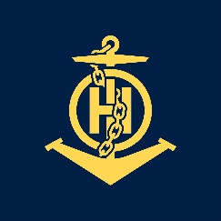
CAT B PROYECT CHART
IHO – NIPPON FOUNDATION
ALUMNI SEMINAR
Lizardo Caro Martinez

Slide 2
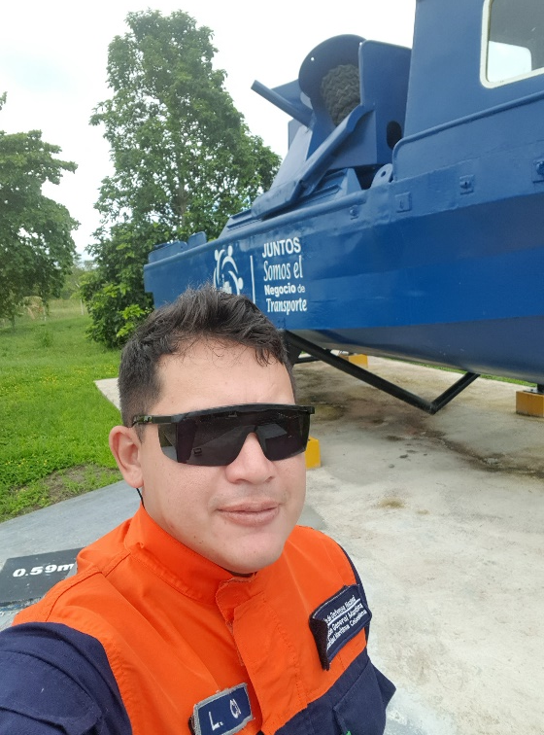
Self introduction
IHO – NIPPON FOUNDATION
ALUMNI SEMINAR
Name | Lizardo Caro Martínez
Alumni year | 2016
Country | Colombia
Organization | General Maritime Directorate (DIMAR)
Position/Job title | Cartographer
Current job description | I currently work as a cartographer of the hydrographic service of Colombia, in charge of compiling new bathymetric information, coast line, port construction, verifying navigation aids and everything associated with the cartographic production process
Please put your photo here!

Slide 3
My career path and projects / Achievements
IHO – NIPPON FOUNDATION
ALUMNI SEMINAR
Since I finished the CAT B course:
09 Nautical paper New edition.
05 INT Chart
10 courses trained for naval officers and petty officers school.
02 Planning and organization the XIII Regional meeting South-East Pacific Regional Hydrographic Commission (SPRHC - ) and XIX Regional meeting Meso American – Caribbean Sea Hydrographic Commission (MACHC).
05 Cartographic reconnaissance of five different of the principal port of Colombia

Slide 4
Lessons learned from CHART Course
IHO – NIPPON FOUNDATION
ALUMNI SEMINAR
Universal language.
Under pressure.
Technology doesn´t mean it will be easy.
Alma matter.
Big family

Slide 5
Suggestion for the future
IHO – NIPPON FOUNDATION
ALUMNI SEMINAR
To Nippon foundation:
“Actions speak louder than words, Nippon Foundation, OHI and UKHO know the meaning of the humankind that is to take care of each other, continue supporting the formation of the language spoken by the sailors of the world”

